Slide 1
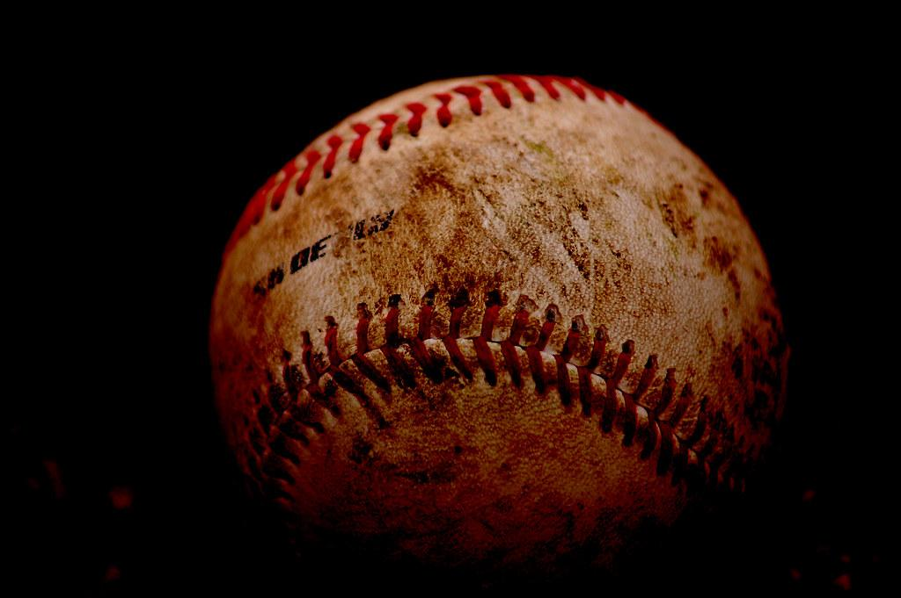
SQL Baseball
GROUP 3: Tierra, Jameisha, Ashu, Keira, Charlie, and Cody

Slide 2
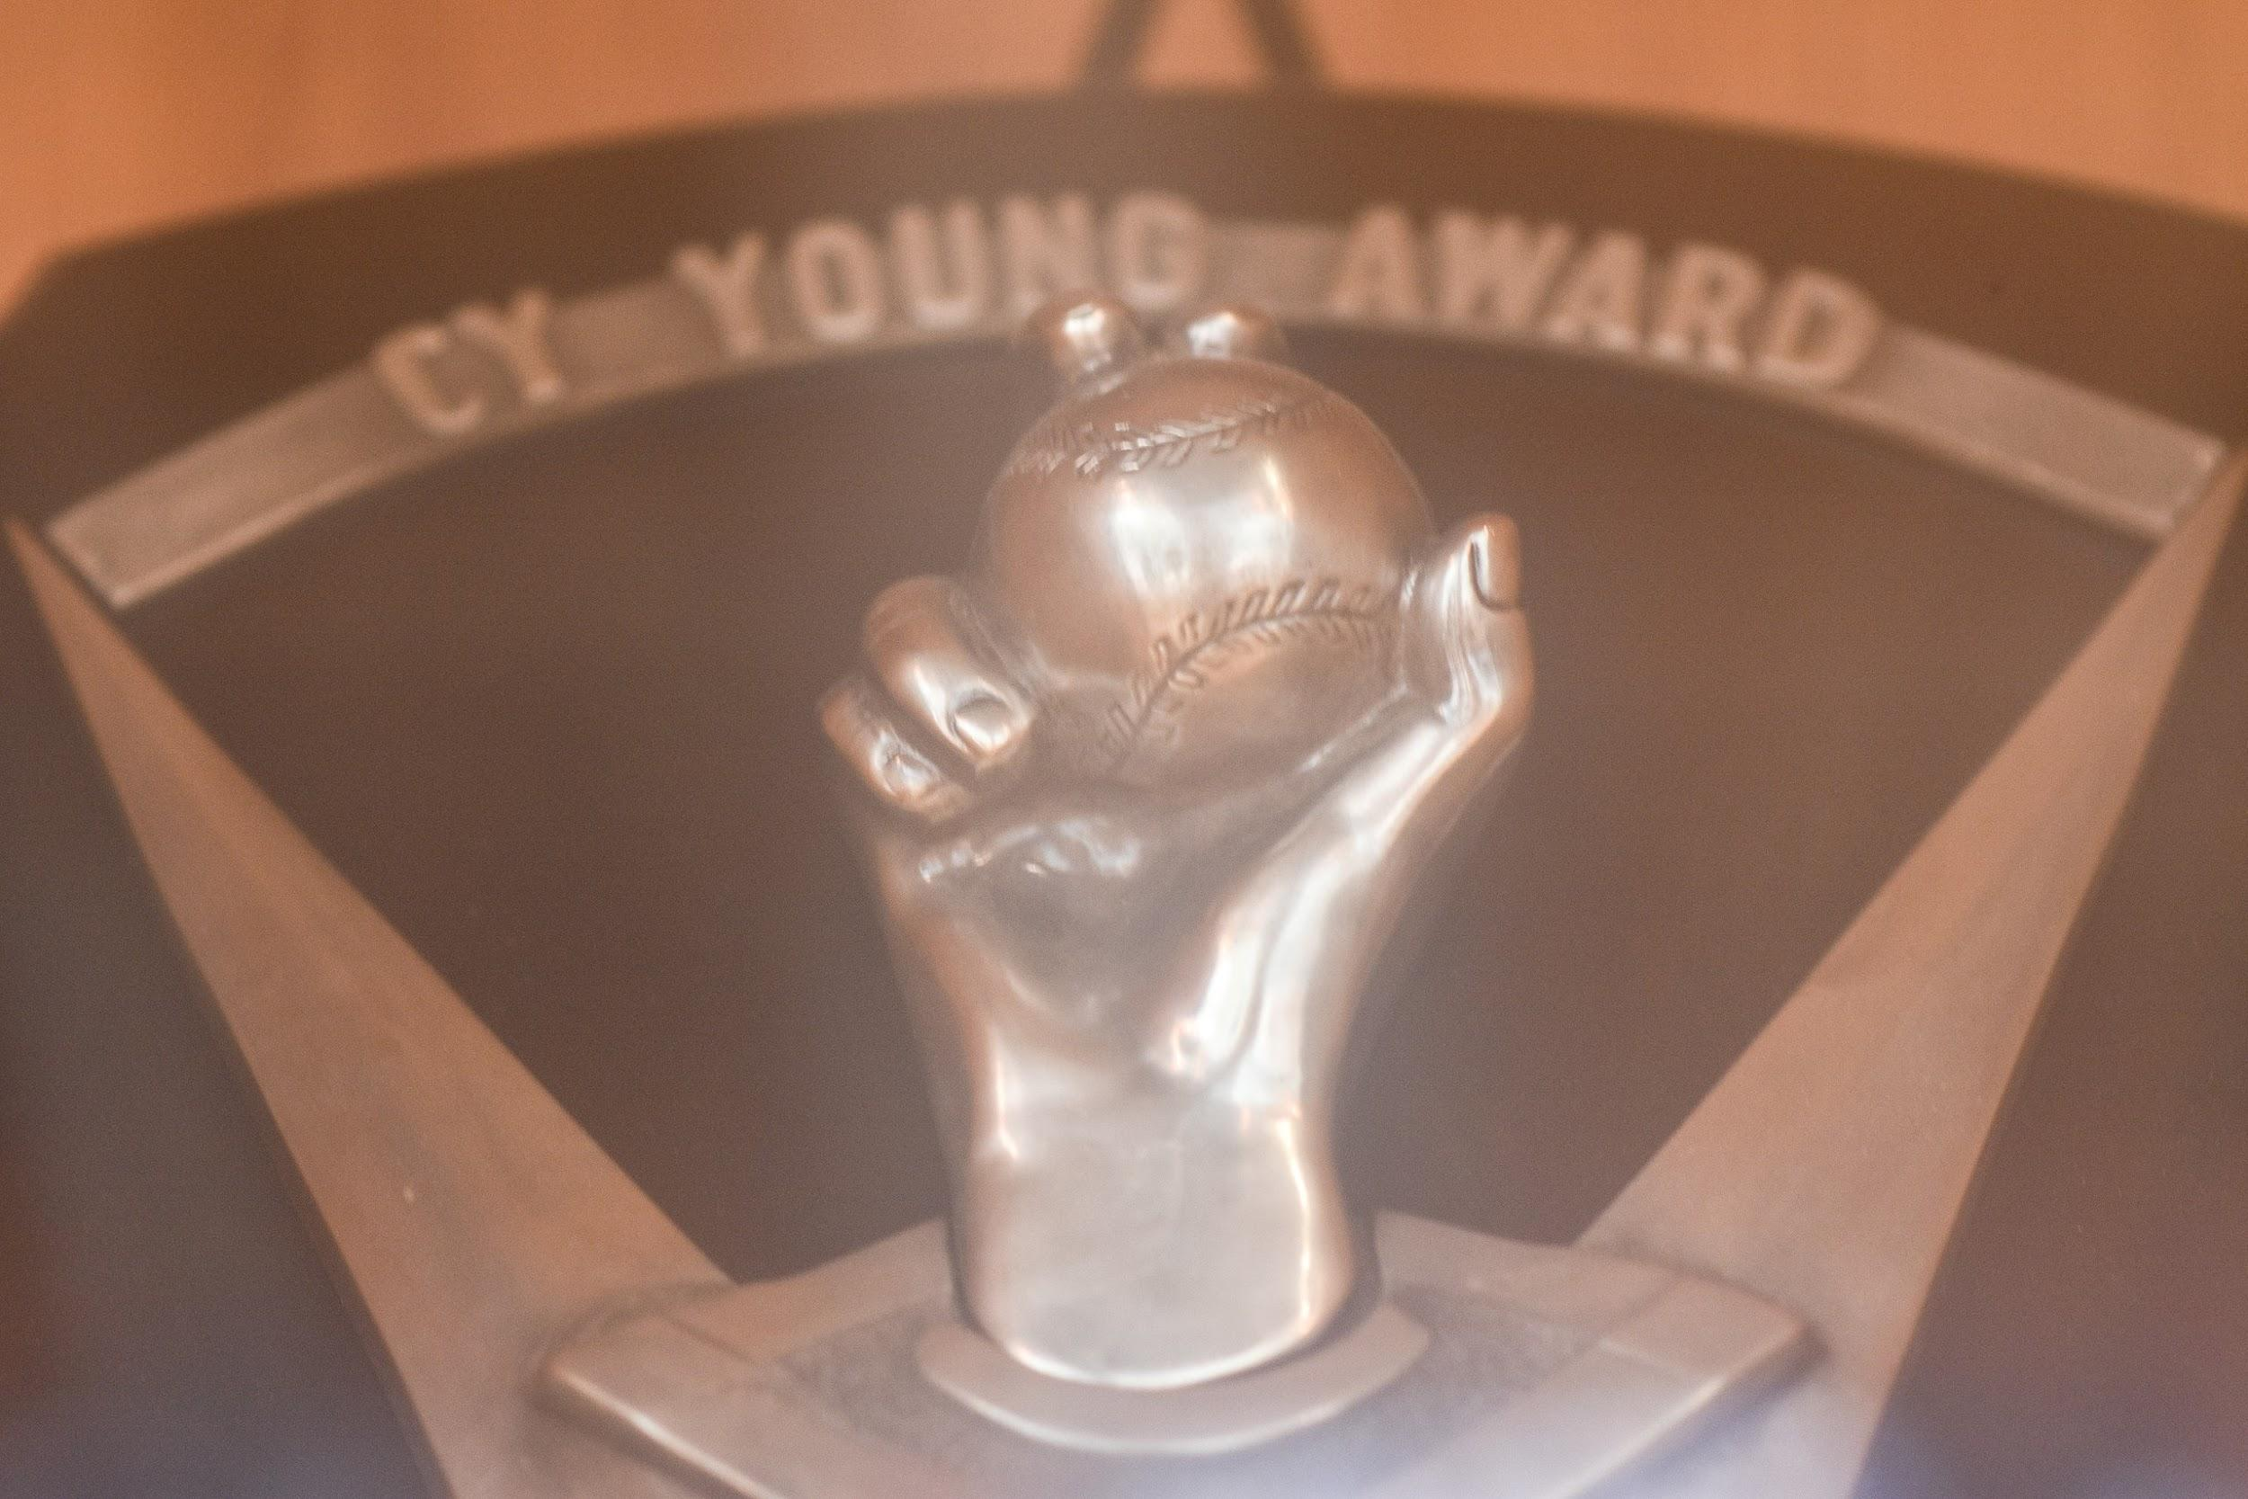
What is the Cy Young Award?
The award used in baseball for the winningest pitcher in baseball history, the Cy Young award is voted upon by the Baseball Writers’ Association of America prior to the beginning of the postseason. From 1956 to 1966, the award was given to one pitcher, but has been given to one pitcher per league since 1967.

Slide 3

SQL QUESTION
It is thought that since left-handed pitchers are more rare, causing batters to face them less often, that they are more effective. Investigate this claim and present evidence to either support or dispute this claim. First, determine just how rare left-handed pitchers are compared with right-handed pitchers. Are left-handed pitchers more likely to win the Cy Young Award? Are they more likely to make it into the hall of fame?

Slide 4

Thoughts… Query Used
SELECT pl.throws AS 'Right or Left Handed', ROUND(AVG(p.ERA),3) AS 'Regular Season ERA', ROUND(AVG(pp.ERA),3) AS 'Post-season ERA', COUNT(DISTINCT p.playerID) AS 'Number of Pitchers'
FROM pitching AS p
JOIN pitchingpost AS pp
ON p.playerID = pp.playerID
JOIN people AS pl
ON p.playerID = pl.playerID
WHERE pl.throws IS NOT NULL
GROUP BY throws;

Slide 5
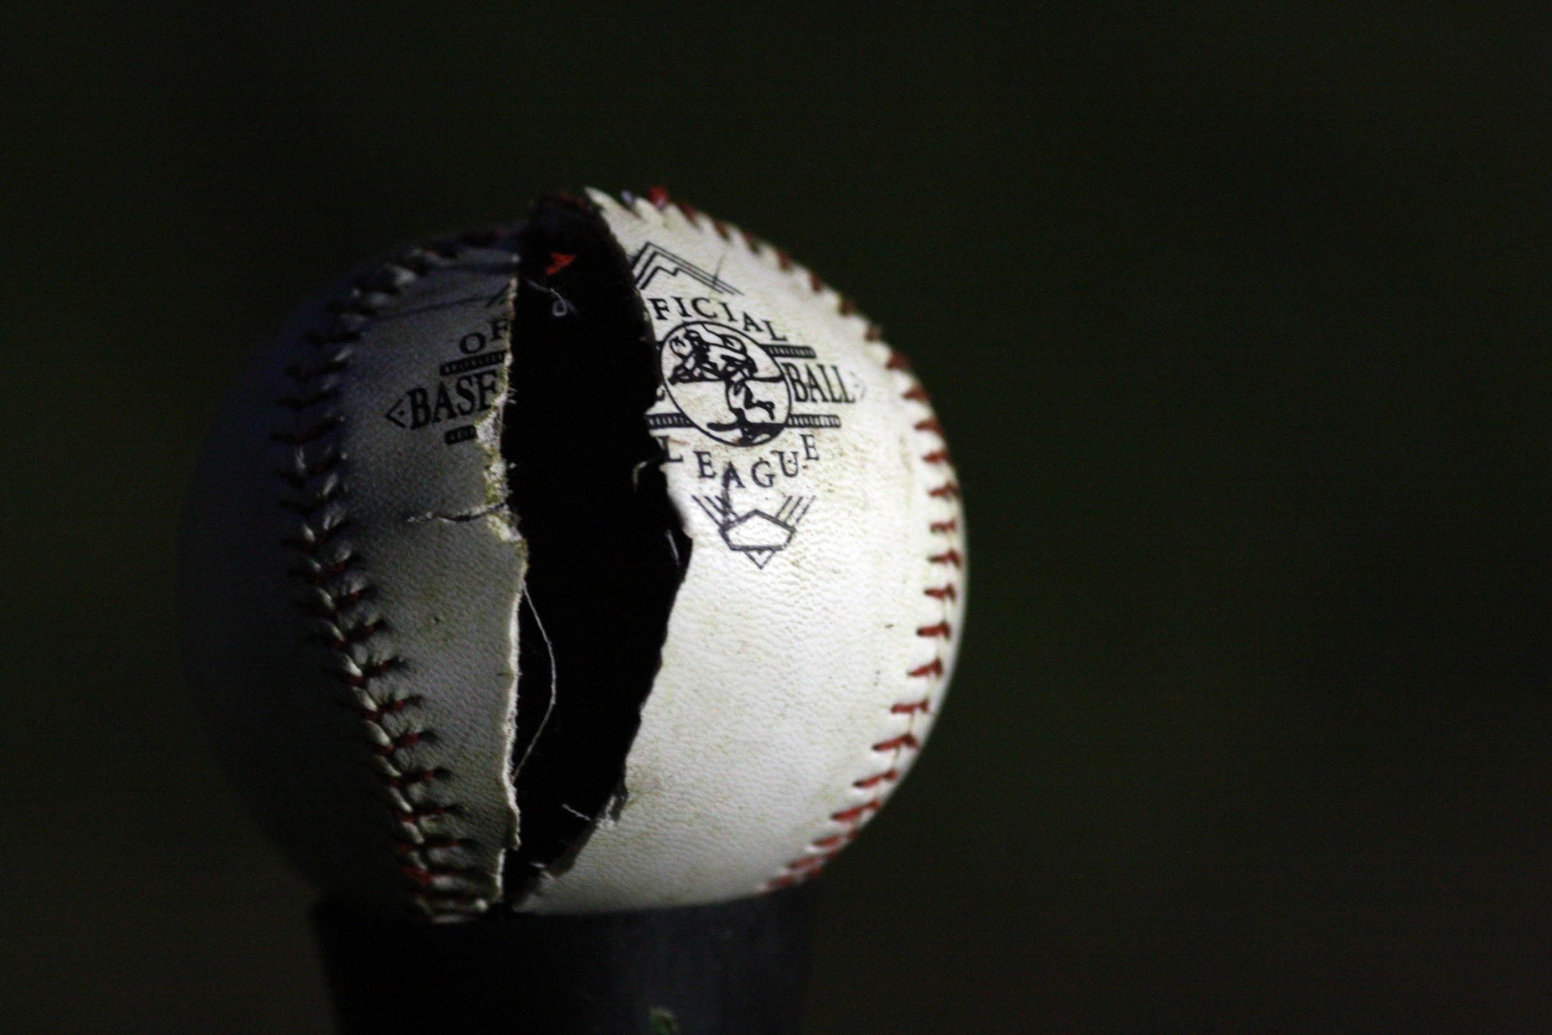
Left-handers show an ERA 0.366 lower on average than right-handers.
During post-season play, where games are played in series to determine who moves closer to the World Series championship, differences in ERAs like this over multiple games can determine who moves on to the next round.
This though may be due to the fact that, over the course of the regular season, batters become accustomed to facing an overwhelmingly abundant amount of right-handers, and a comparatively small amount of left-handed pitchers, meaning that most of their batting technique is learned in order to get hits off of right-handers.
When the post-season comes around, these batters are under an enormous amount of pressure to perform, so that they can move their teams closer to the World Series championship, and as a result, any disruption, such as having to face a left-hander pitcher, can cause a batter no small amount of difficulty.
Thoughts cont… Post Season

Slide 6
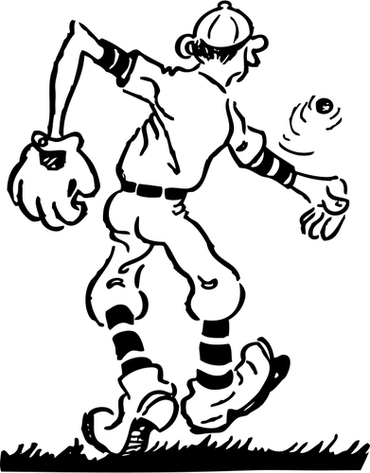
We examined the data, comparing the pitchers by ERA.
During the regular season, left- handers don’t seem to be appreciably more effective than right-handers.
Right-handers have an ever-so-slightly lower regular season ERA than left handers on the whole, though the difference (roughly 0.035) is statistically insignificant.
We concluded that, during the regular season, neither type of pitcher is significantly more effective than the other.
Thoughts cont… Regular Season

Slide 7

Based on our data exploration, left-handed pitchers are not more likely to win the Cy Young award than right-handers, although given the distribution of left-handed and right-handed pitchers across the database, this is probably simply because of the abundance of right-handers, rather than because one group is more effective at pitching than the other.
Final Thoughts!

Slide 8
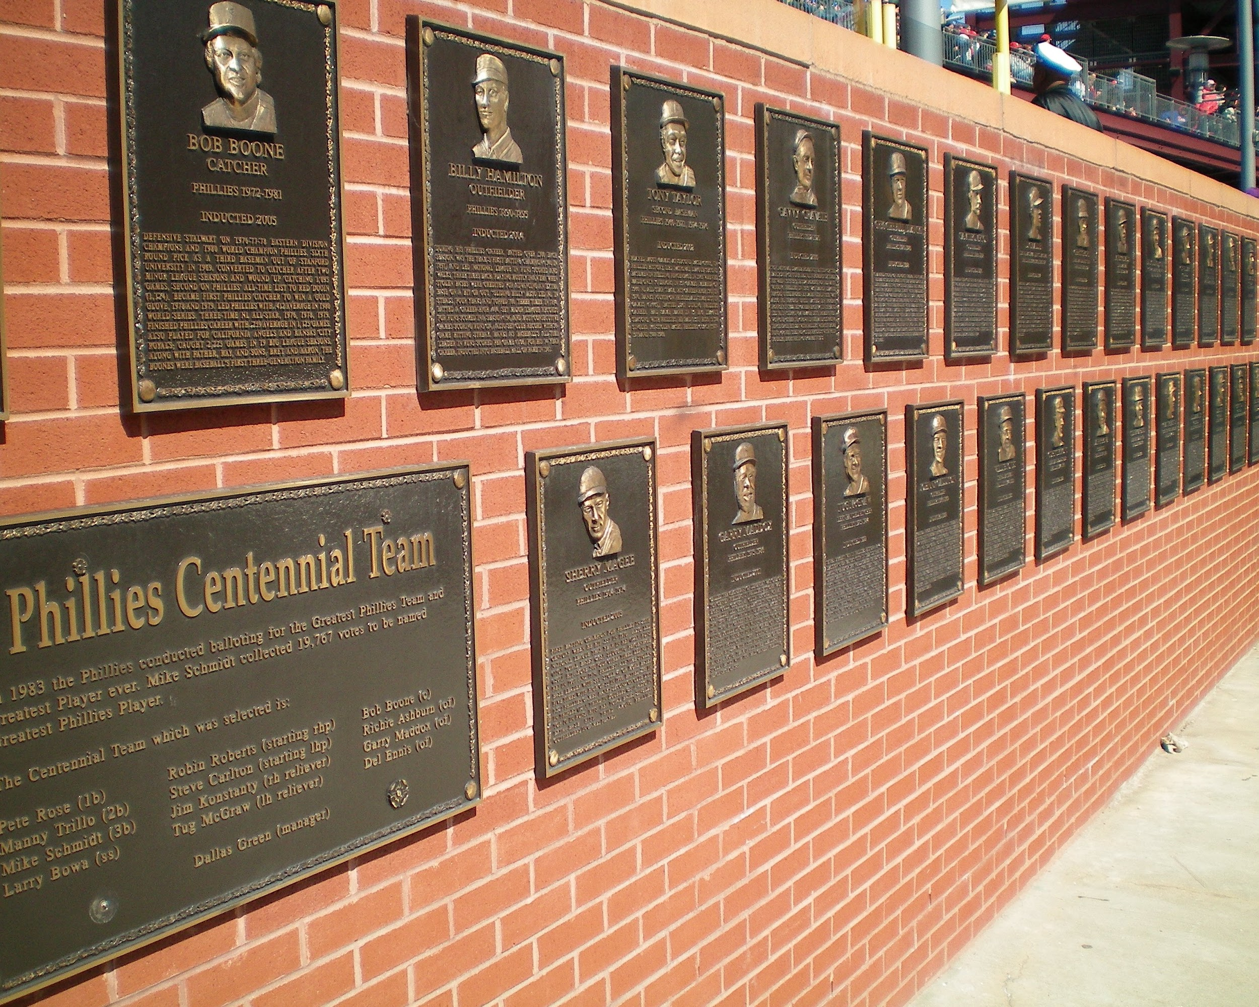
Based on our data exploration, left-handed pitchers are not more likely to be inducted into the Hall of Fame than right-handers, although again, given the distribution of left-handed and right-handed pitchers across the database, this is probably simply because of the abundance of right-handers, rather than because one group is more effective at pitching than the other.
Final Thoughts!... Hall of Fame

